Slide 1


CLASSICAL BALLET
WEEK 16

Slide 2

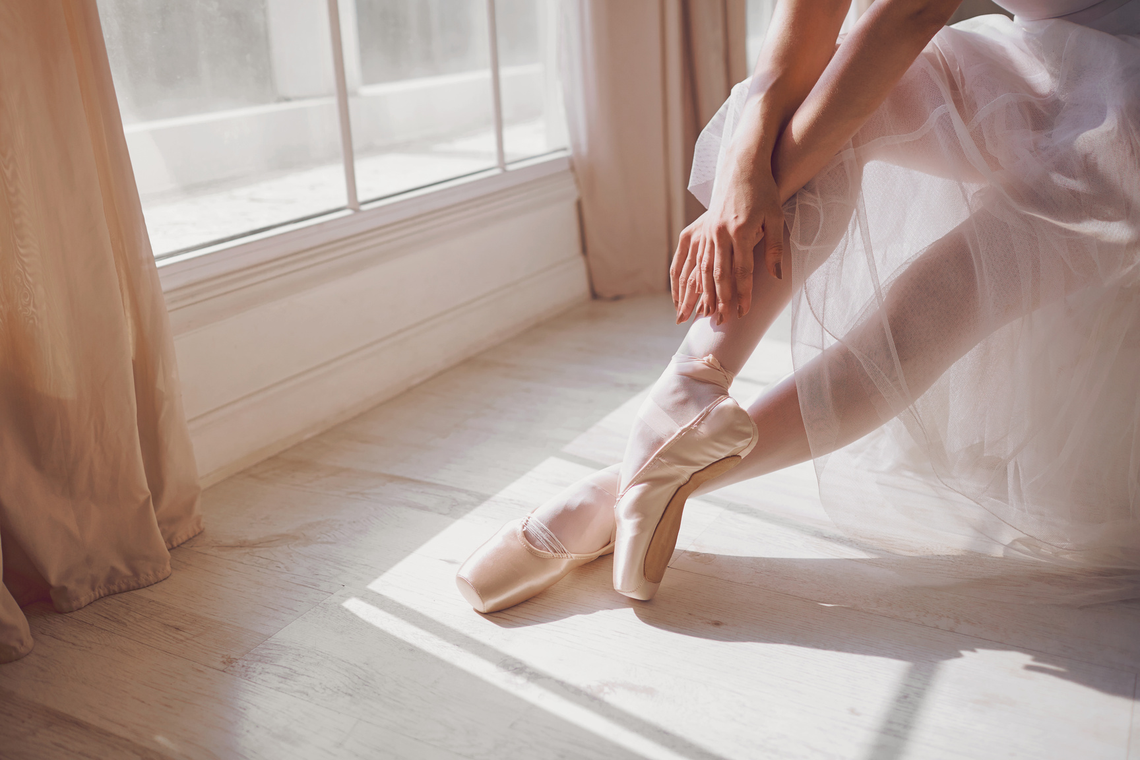
Characteristics
CLASSICAL BALLET

Slide 3
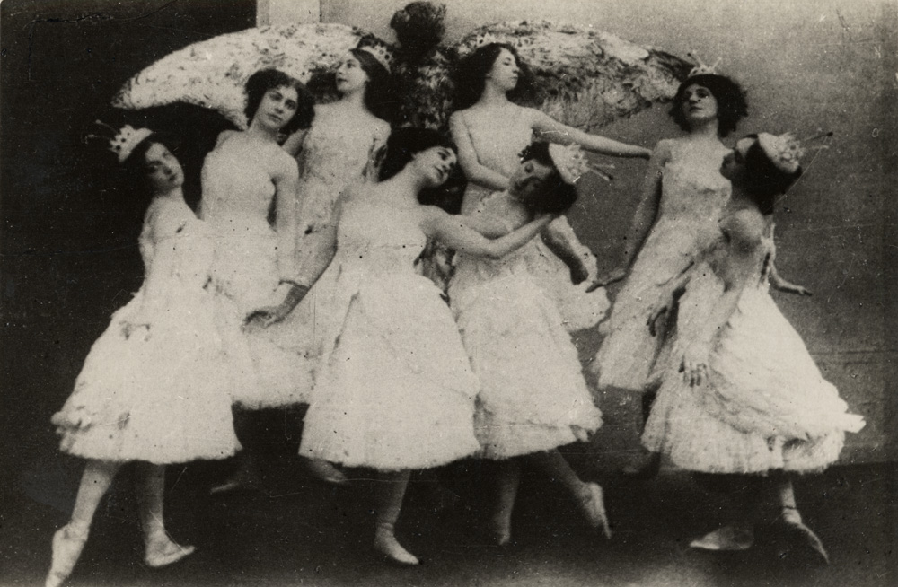
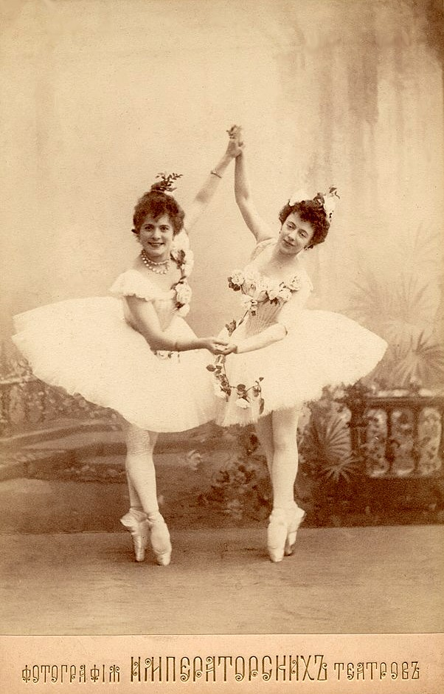
Origin
CLASSICAL BALLET
Classical Ballet is a highly formalized and stylized dance that originated in Italy but was later developed in France and Russia. Classical ballet have become an integral part of courtly entertainment, however it was in France where the classical ballet truly began to take shape and gain prominence as we know today.

Slide 4

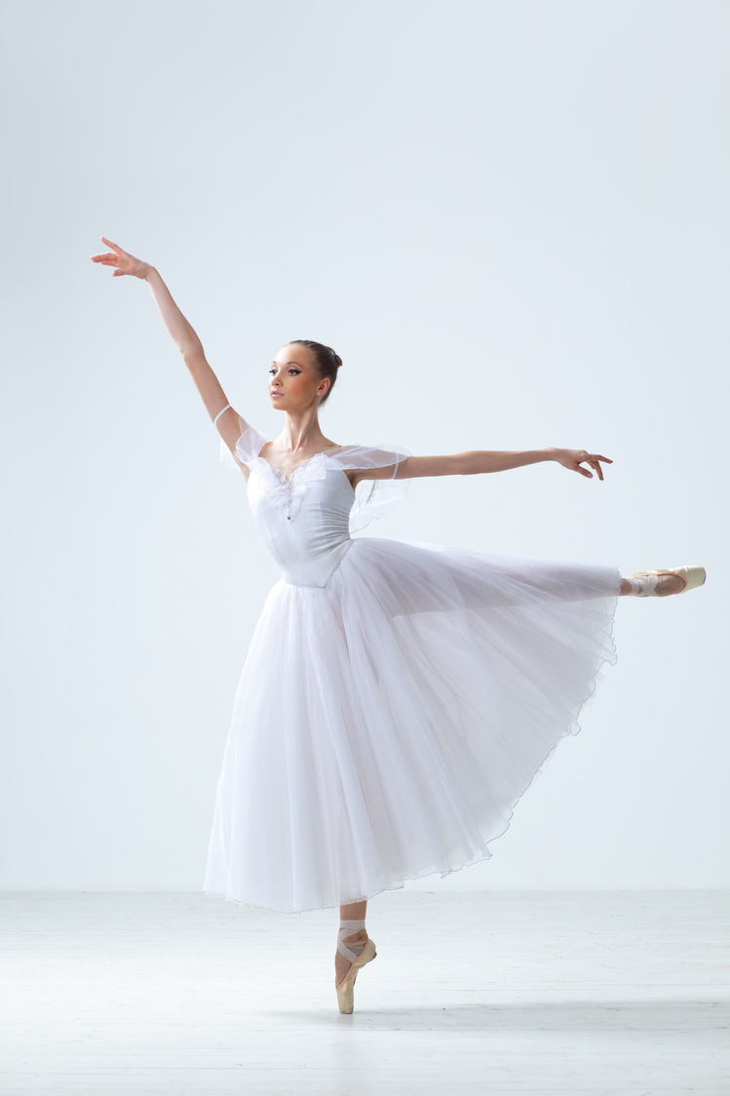
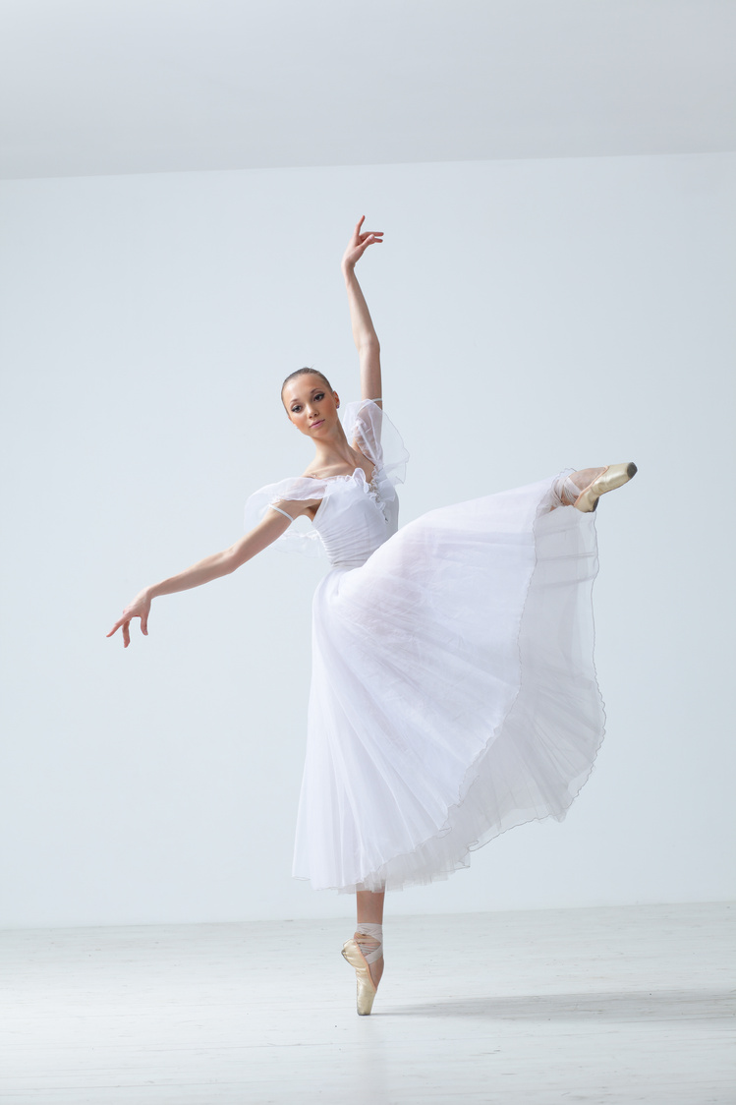
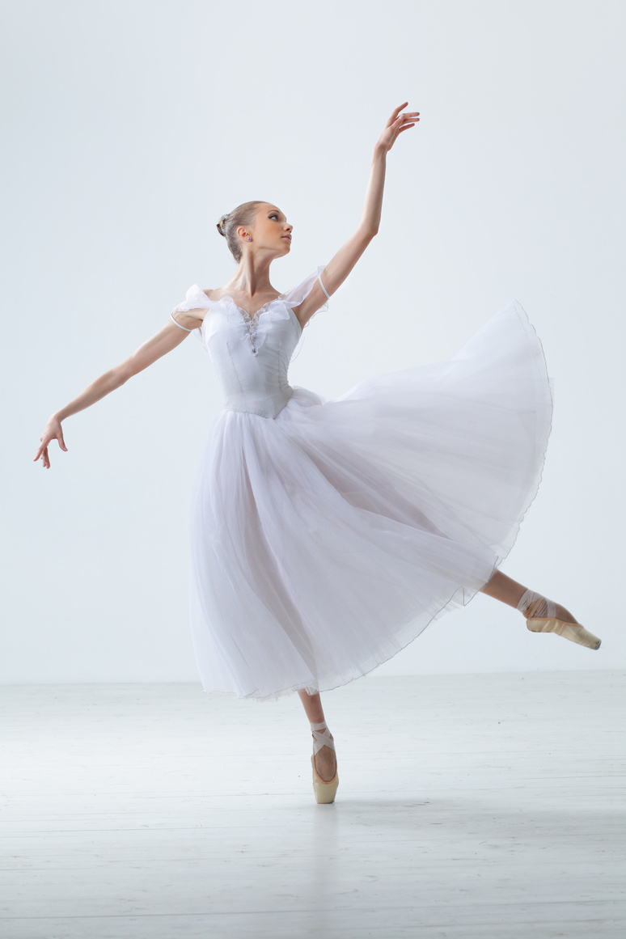
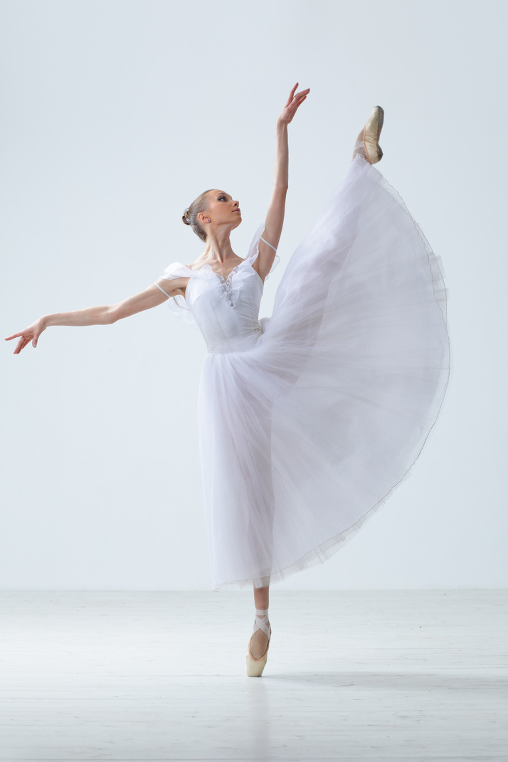
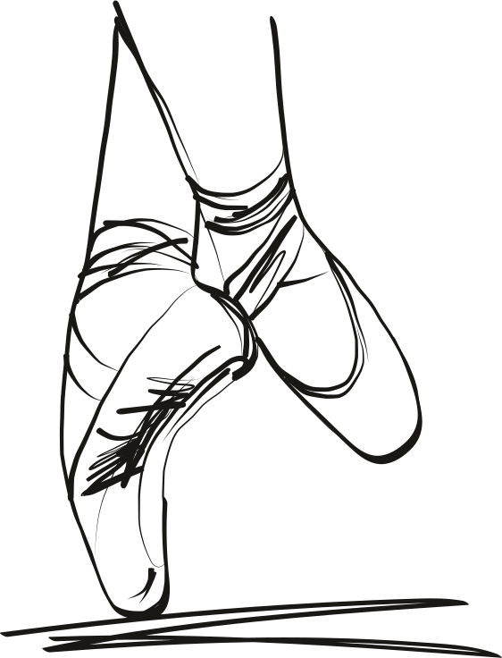
Characteristics
Precision - Classical Ballet is known for requiring it's dancers to achieve high level of precision through rigorous and demanding training.
Pointee Technique - It is a part of classical ballet involving a technique that concerns pointe work, wherein a ballet dancer supports all of their body weight on the tips of fully extended feet when wearing pointe shoes.

Slide 5
Characteristics
Grace and Elegance - Classical ballet is known for its graceful and elegant movements. Dancers aim to create a sense of flow and continuity in their motions, emphasizing long lines, extensions, and a sense of effortlessness.
Narrative and Storytelling - Many classical ballets are narrative in nature, telling stories through dance. Famous ballets like "Swan Lake," "The Nutcracker," and "Giselle" have intricate plots and characters portrayed through dance, music, and expressive gestures.

Slide 6
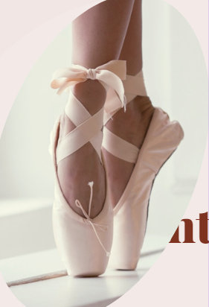
Movement Skills
CLASSICAL BALLET

Slide 7
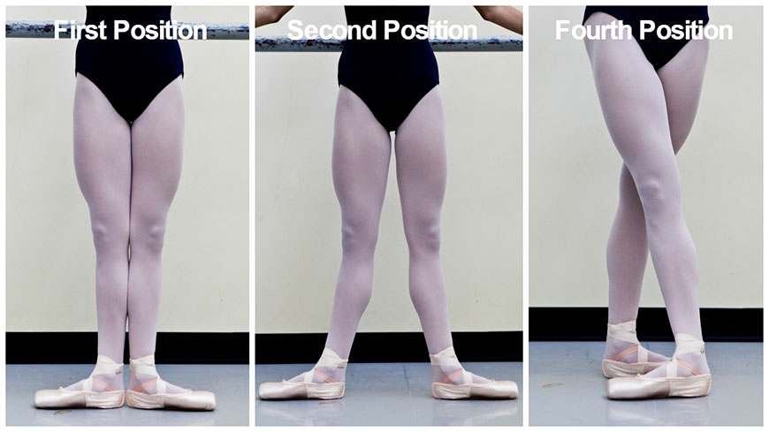
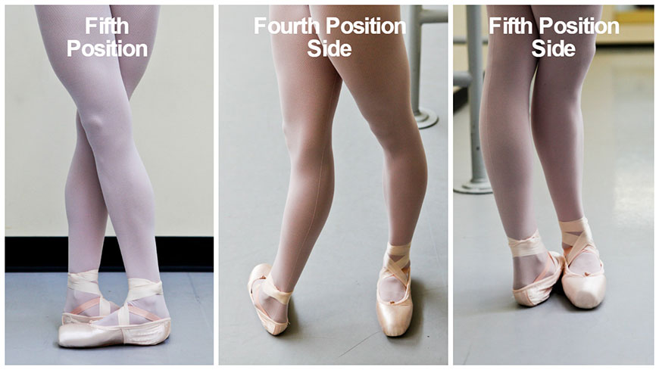
Basic Leg Movements
CLASSICAL BALLET
NOTE! The third position is ''rarely'' used in actual classical ballet dances as they are only used to teach beginners to achieve the fifth position, hence the third position looks very similar to the fifth position.

Slide 8
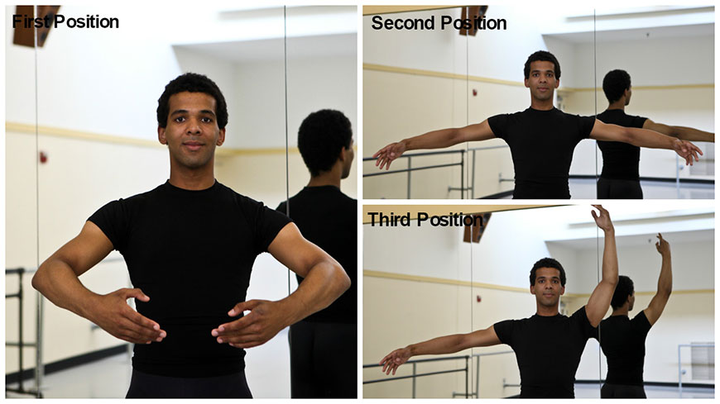
Basic Arm Movements
CLASSICAL BALLET

Slide 9
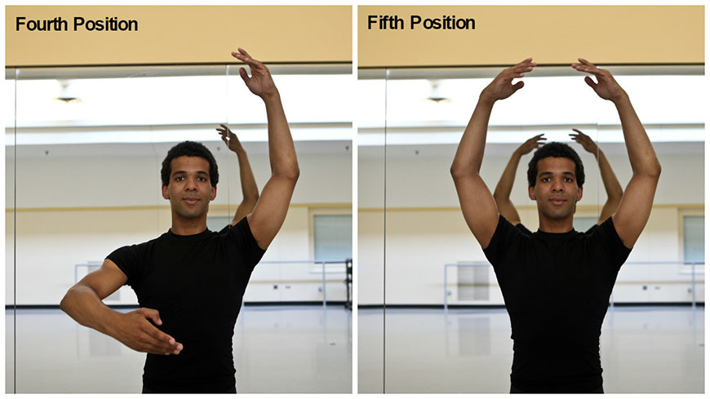
Basic Arm Movements
CLASSICAL BALLET

Slide 10

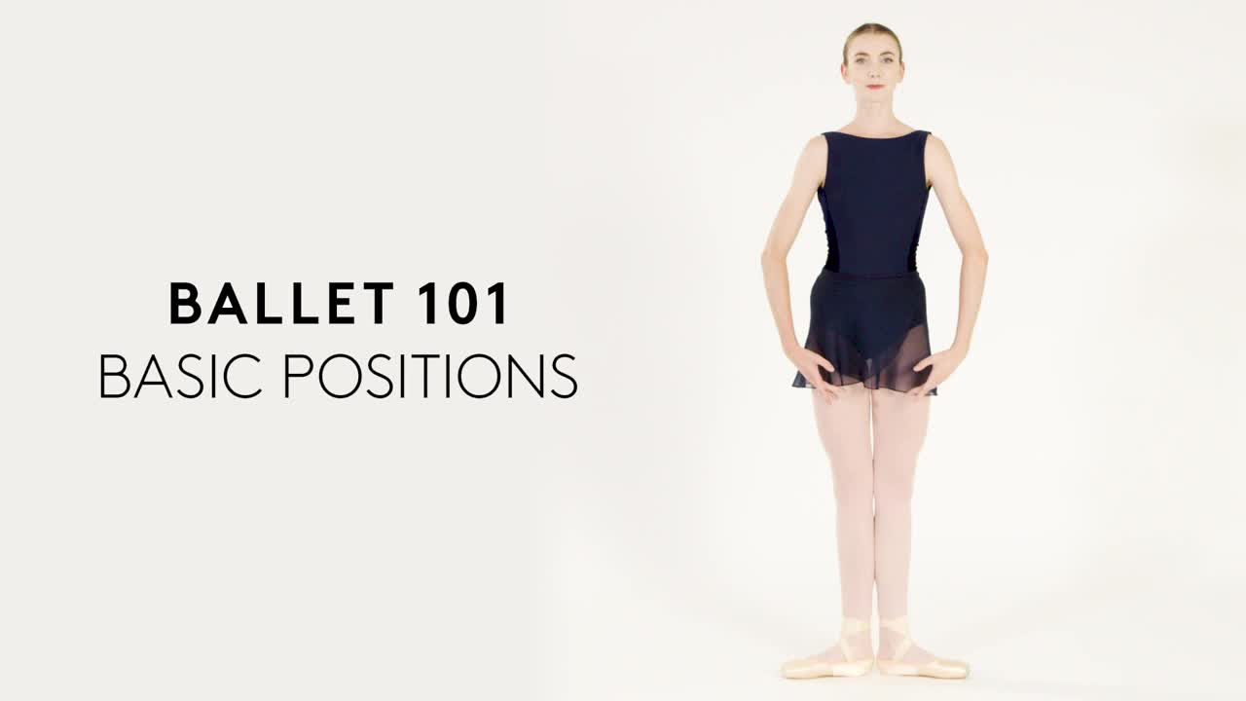
Example Video

Slide 11

Example Video

Slide 12
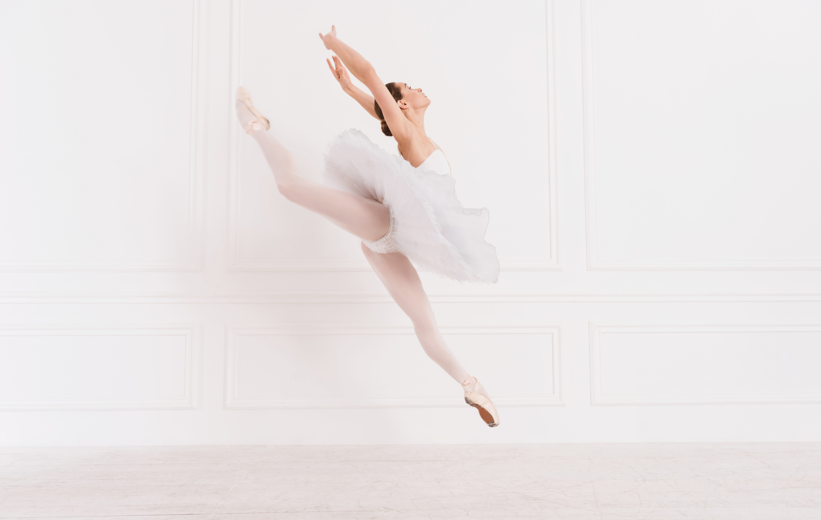
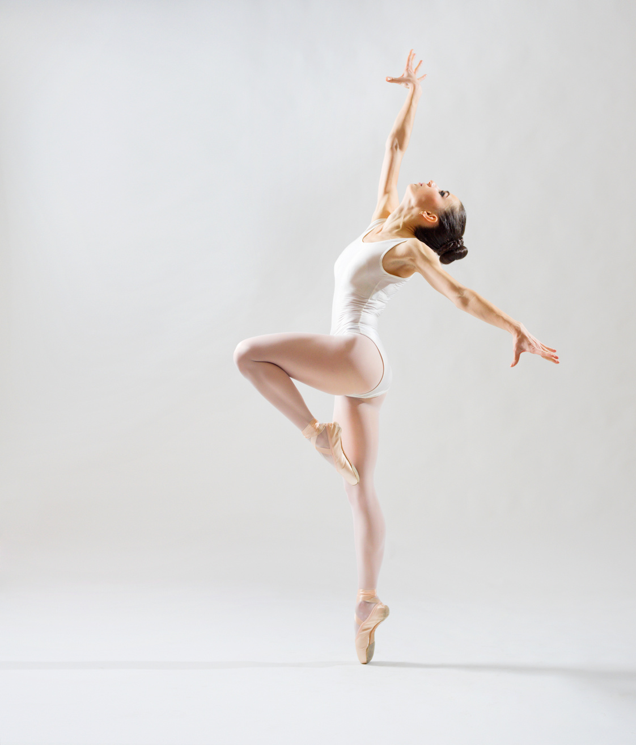
Movement skills
BODY POSTURE
BALANCE
(Alignment of spines) It is a crucial part of training and not only affects every movement or step you take in ballet, but it also helps form the right muscles for your body.
Even the tiniest adjustments, such as tilting your pelvis or having your weight backwards, can absolutely prevent you from mastering a step. In ballet, it is the small details which matter the most.
(Correct Weight Placement) mastering the right balance falls into place with having the correct posture. The two skills work together and enable you to have a strong core stability, allowing balancing to be effortless.

Slide 13
Movement skills
ALIGNMENT
MOBILITY
(Having two body parts being in a line with each other) is one of the key elements in a ballet dance lesson to make sure your overall technique is clean and precise.
This would mean having the knees over the toes when in a demi plie, or keeping the leg in front of you when in a tendu devant.
(The ability to move or be moved freely and easily) Every dancer tends to have very mobile joints in the feet, ankles and hip joint. With all the training that you do, your body naturally become very versatile and you can adjust to all sorts of positions

Slide 14
Movement skills
CO- ORDINATION
STRENGTH
(When the body does two things at once) s important to every dancer, no matter what stage you are at. If you have the right sense of co-ordination, it will allow each movement to be easier and it helps secure those challenging steps.
(Physical power and energy) Being strong and having strength is something you can't just pull off in one ballet dance lesson. It isn't just the number of repetitions that increase the strength but the high loads, such as holding the leg in extension.

Slide 15

Movement skills
FLEXIBILITY
(Mobility in the joints and elasticity of muscles) is a skill that has to be approached intelligently when trying to improve. It is easy to overstretch and tear the muscles, so you must stretch on a gradual basis.

Slide 16
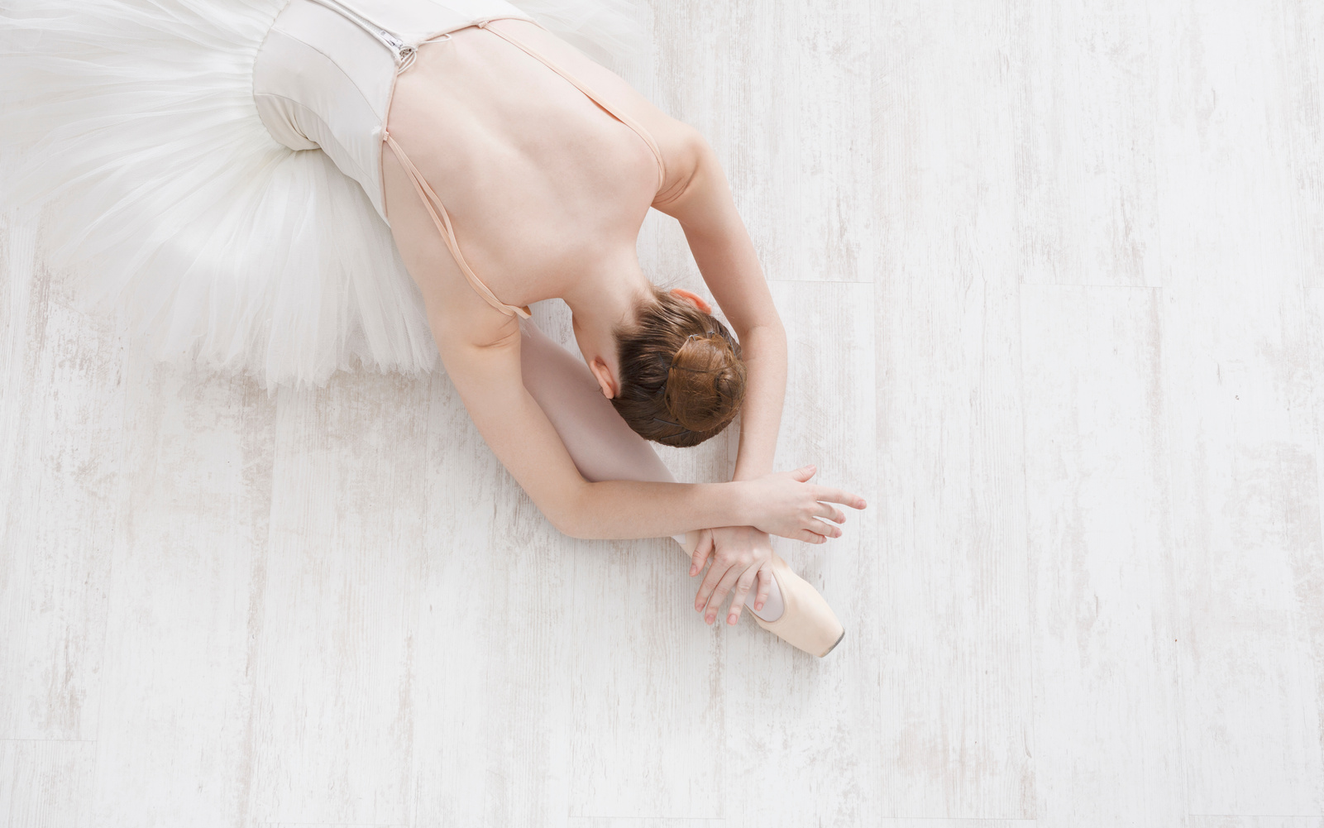
Fitness Benefit
CLASSICAL BALLET

Slide 17

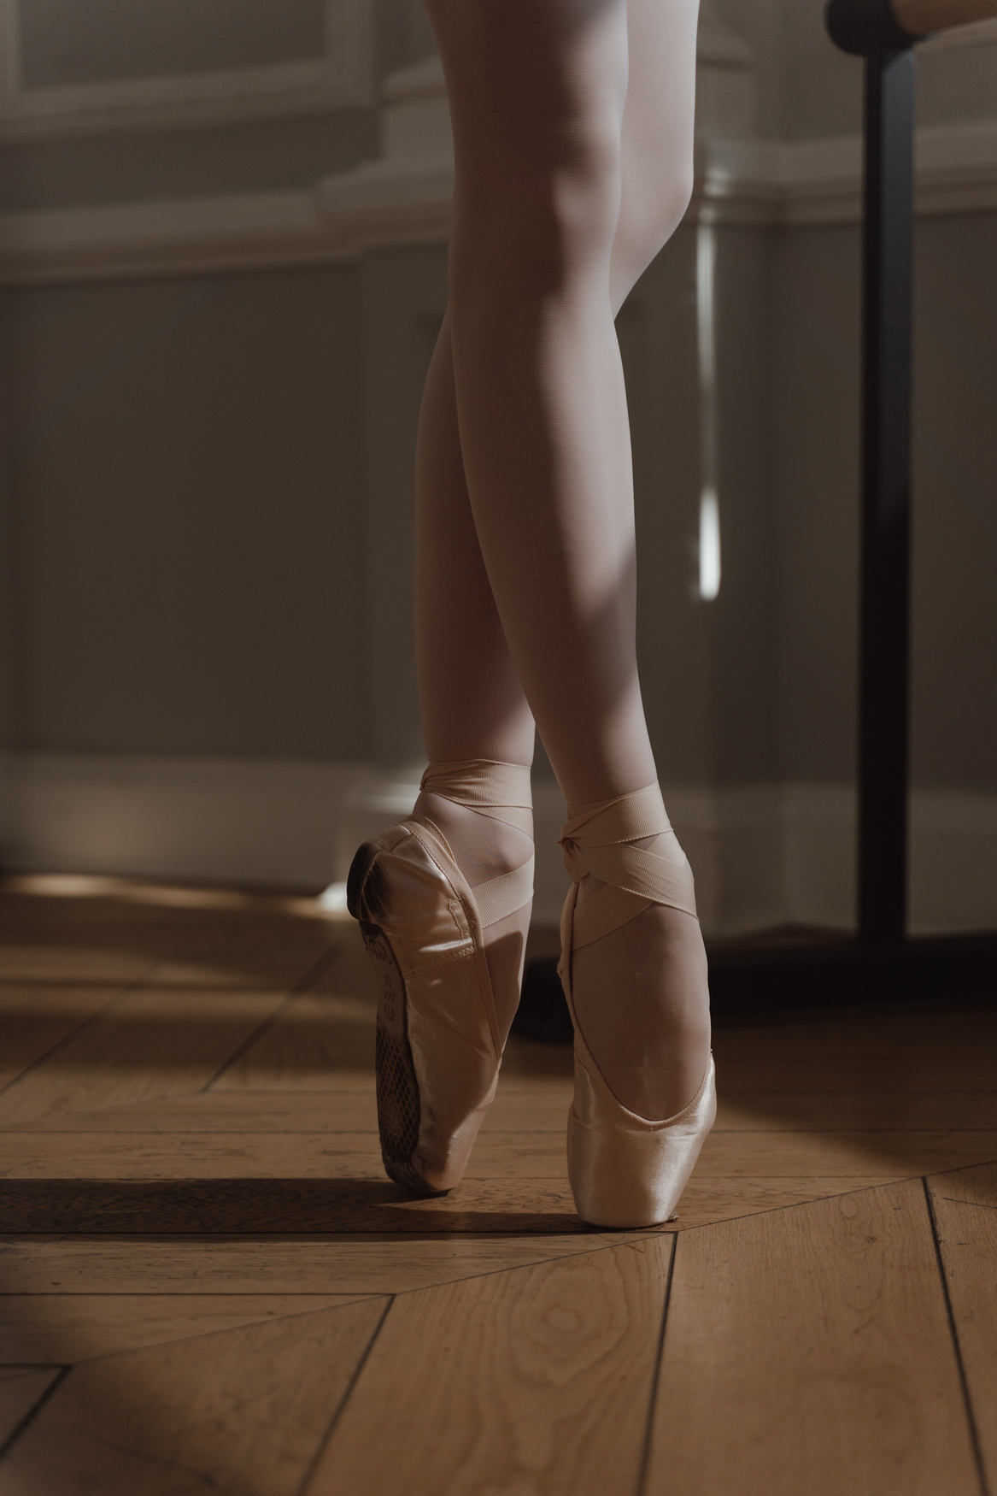


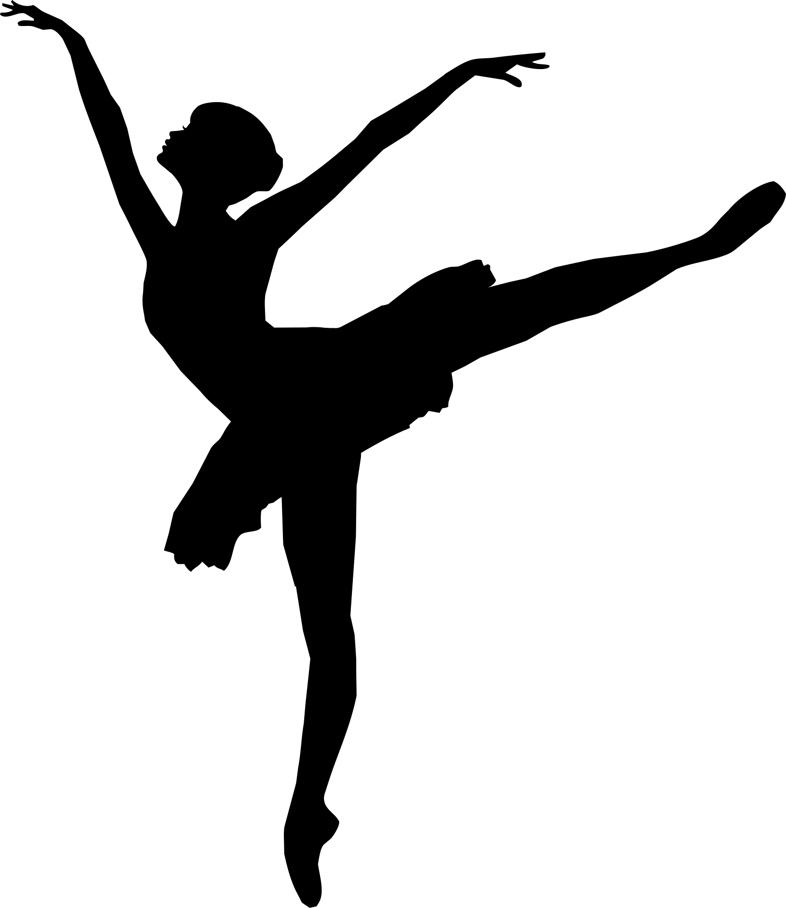
Fitness benefit
MUSCLE STRENGTH
FLEXIBILITY
In classical ballet, movements require controlled and precise muscle contractions, which helps to develop both upper and lower body strength. Dancers often develop strong and toned muscles, especially in the legs, core, and back.
In ballet, it involves extensive stretching and elongation of muscles. Over time, this helps improve flexibility and range of motion in joints, reducing the risk of injuries and enhancing overall physical performance

Slide 18
Fitness benefit
CORE STABILITY
POSTURE AND ALIGNMENT
Ballet movements engage the core muscles extensively, helping to strengthen and stabilize the muscles that support the spine and pelvis. A strong core contributes to better balance and overall body control.
Ballet places a strong emphasis on proper posture and alignment. Dancers learn to hold themselves with grace and elegance, which can carry over to everyday activities, promoting better spinal health and reducing the risk of posture-related issues.

Slide 19

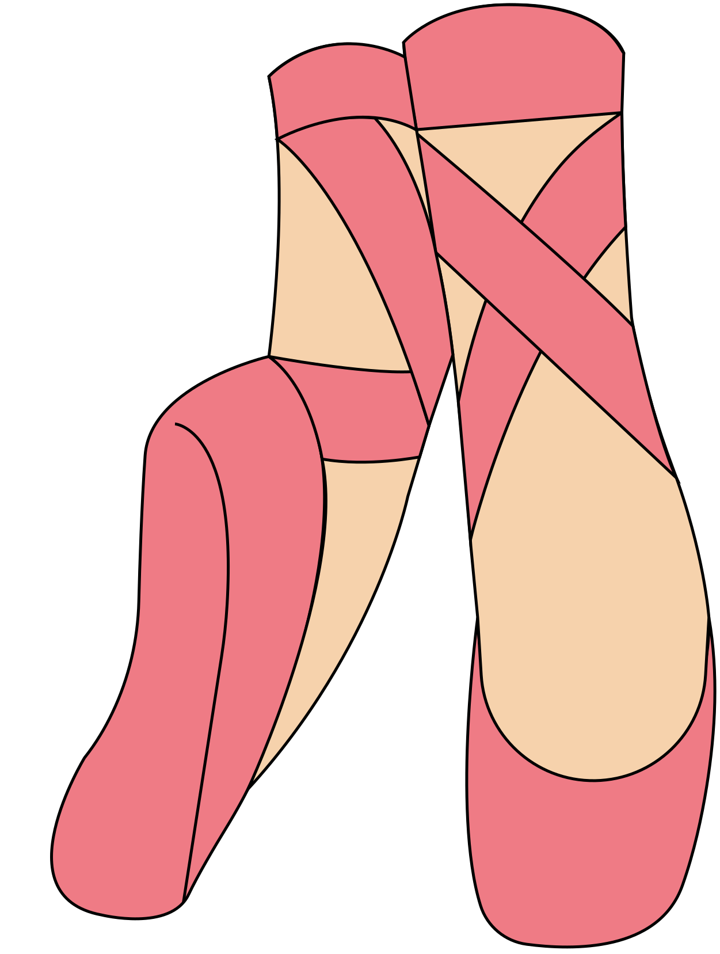
Dietary Goals
CLASSICAL BALLET

Slide 20

Dietary Goals
Classical ballet also emphasizes it's important to maintain a balanced diet that supports the dancer's energy levels, strength, and flexibility to perform the techniques and steps required.

Slide 21
Dietary Goals
PROTEIN
CARBOHYDRATES
helps with muscle repair and growth. Include lean sources like poultry, fish, beans, and tofu.
provide energy for intense dance sessions. Opt for whole grains, fruits, and vegetables
HEALTHY FATS
HYDRATION
support joint flexibility and brain function. Incorporate nuts, seeds, avocados, and olive oil.
stay well-hydrated to prevent fatigue and cramping. Water, herbal teas, and hydrating foods like fruits can help.

Slide 22

Dietary Goals
VITAMINS AND MINERALS
CALCIUM
consume a variety of colorful fruits and vegetables for essential nutrients that aid overall health.
Important for bone health. Include dairy or fortified non-dairy alternatives, leafy greens, and fortified foods.
IRON
SNACKS
helps maintain energy levels. Sources include lean meats, beans, fortified cereals, and dark leafy greens.
have healthy snacks like yogurt, nuts, fruits, or whole-grain crackers to sustain energy during rehearsals.

Slide 23
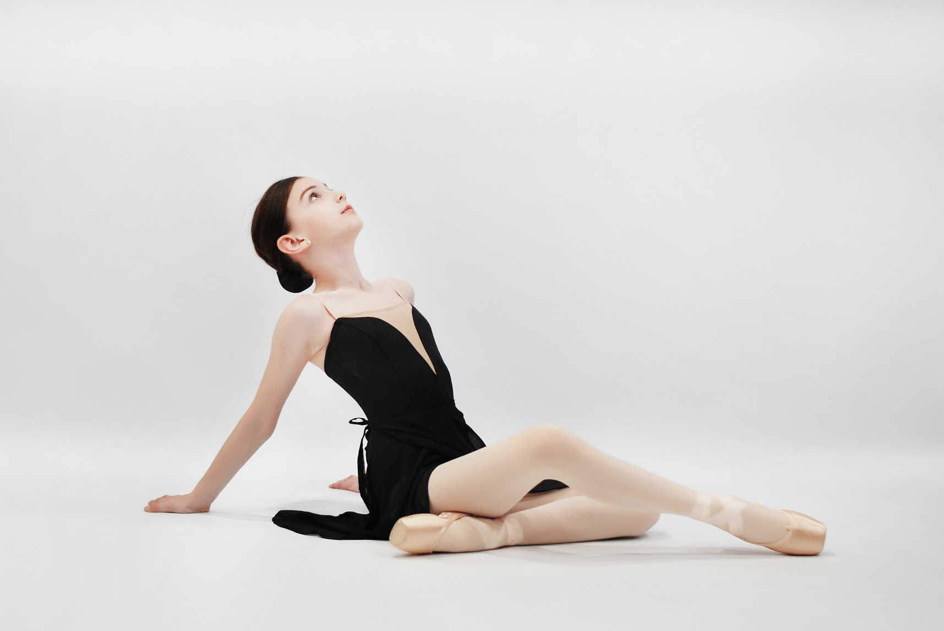
Ballet is a magnificent work of art in the form of dance and has a beautiful story in it.

Slide 24
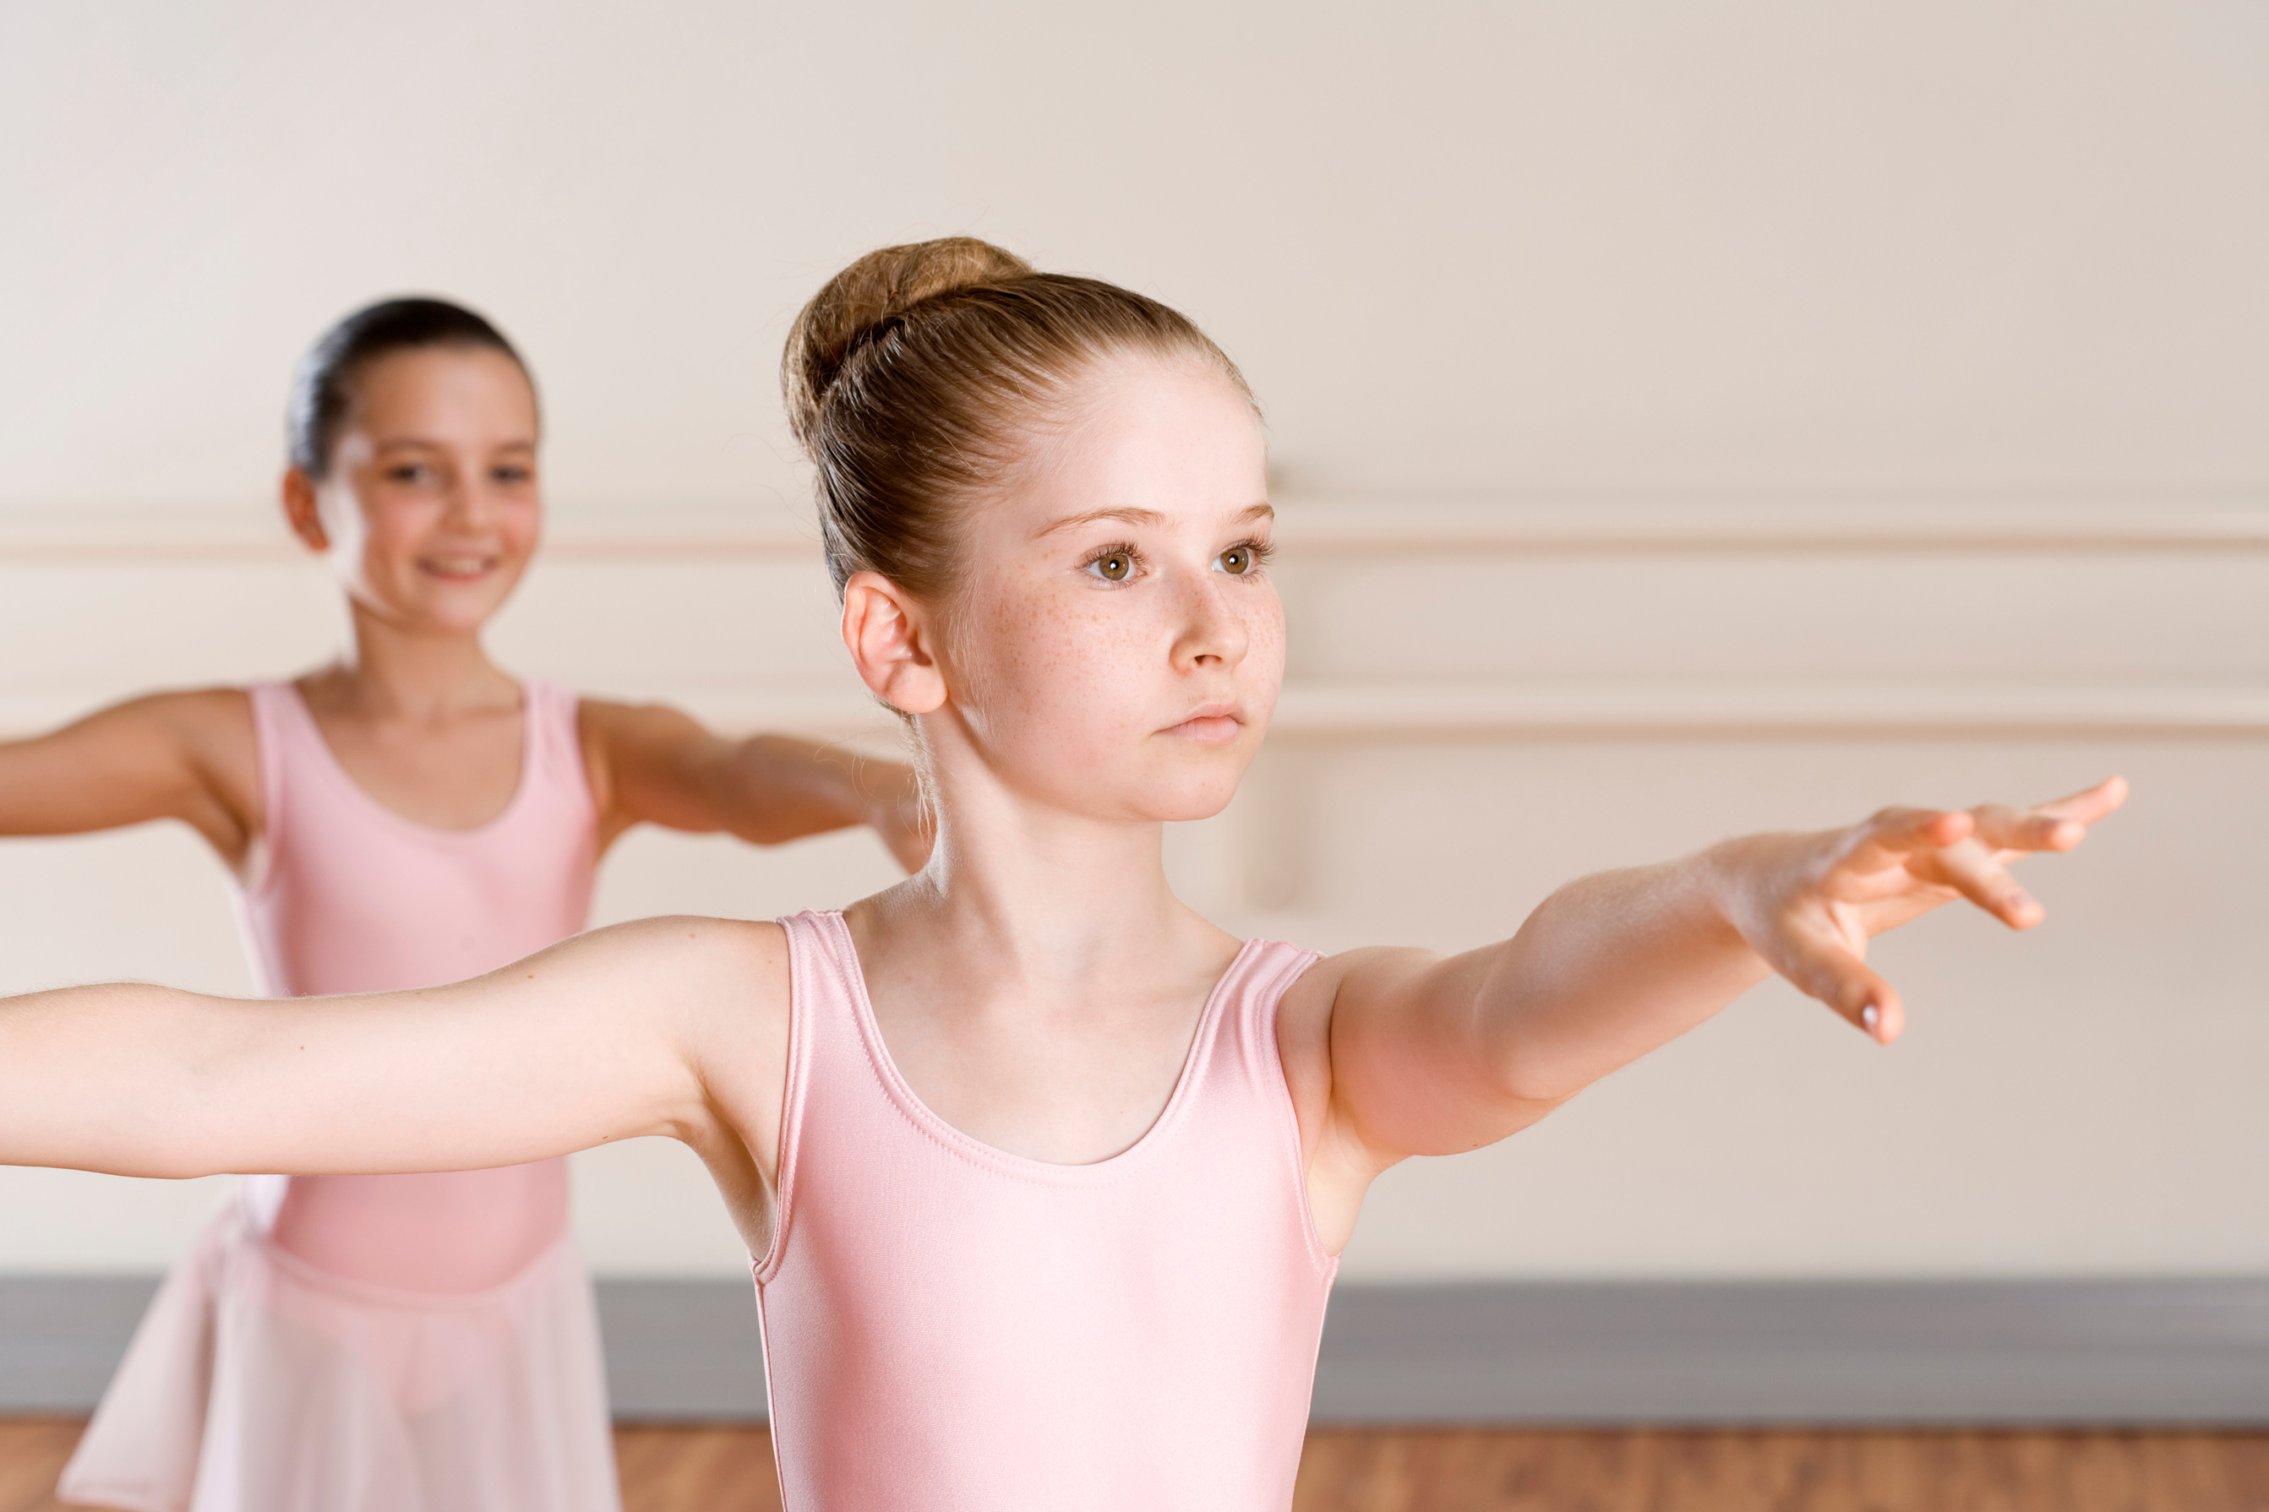
Thank You
CLASSICAL BALLET - WEEK 16

